Slide 1
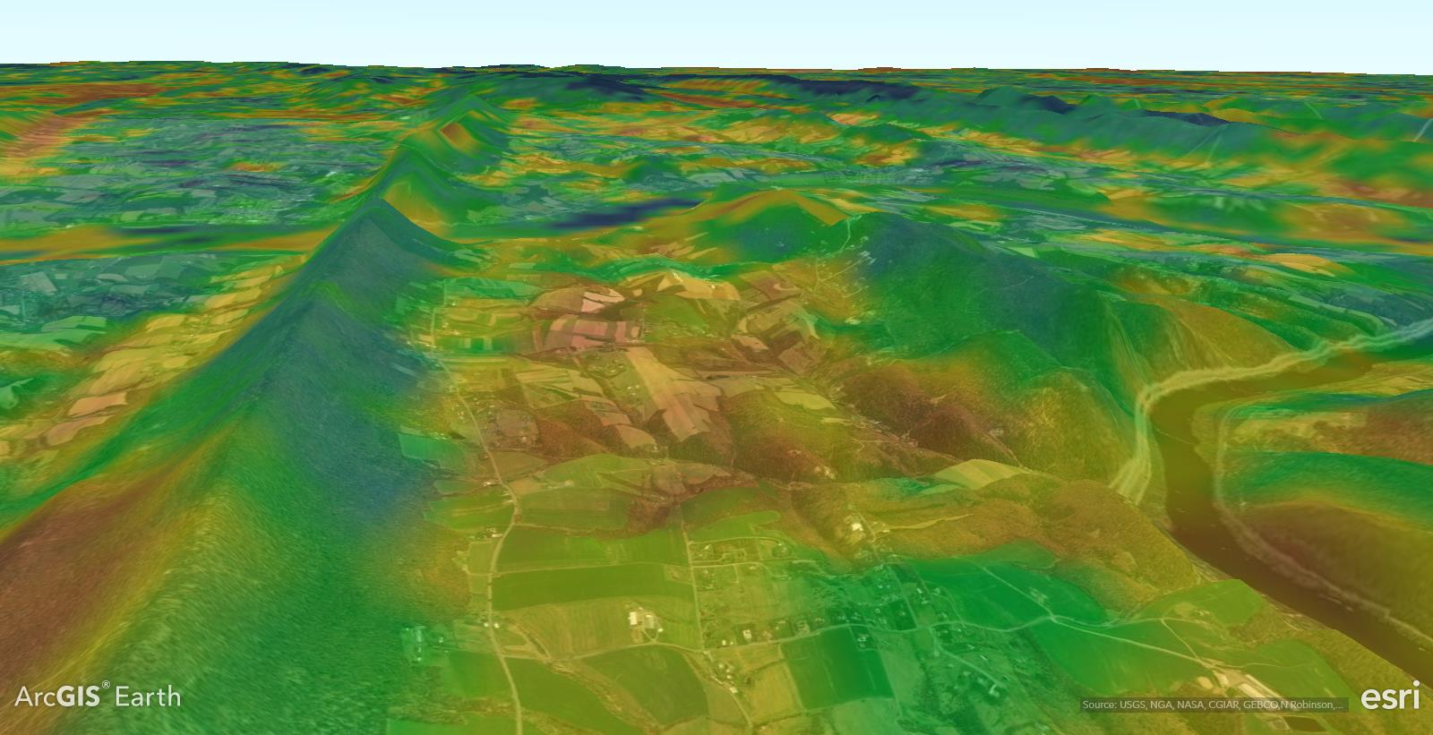
Introduction to W-PAST
Liam Berigan, Amber Roth, Erik Blomberg, Lisa Williams, Ken Duren, Scott Bearer, Timothy Haydt, Daniel Jones
University of Maine & Pennsylvania Game Commission

Slide 2












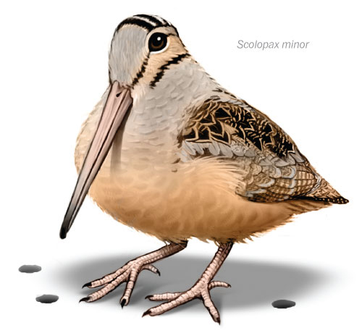


















Eastern Woodcock Migratory Research Cooperative
And growing …
Image: Patterson Clark/The Washington Post
Notes:
Outcome of PGC involvement in the Eastern Woodcock Migratory Research Cooperative
>460 birds tagged with GPS units throughout eastern North America since 2017

Slide 3
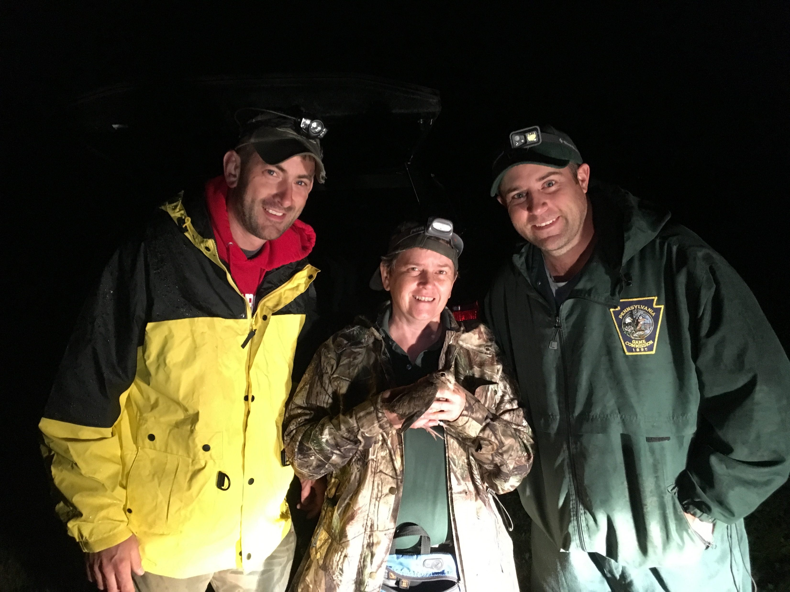
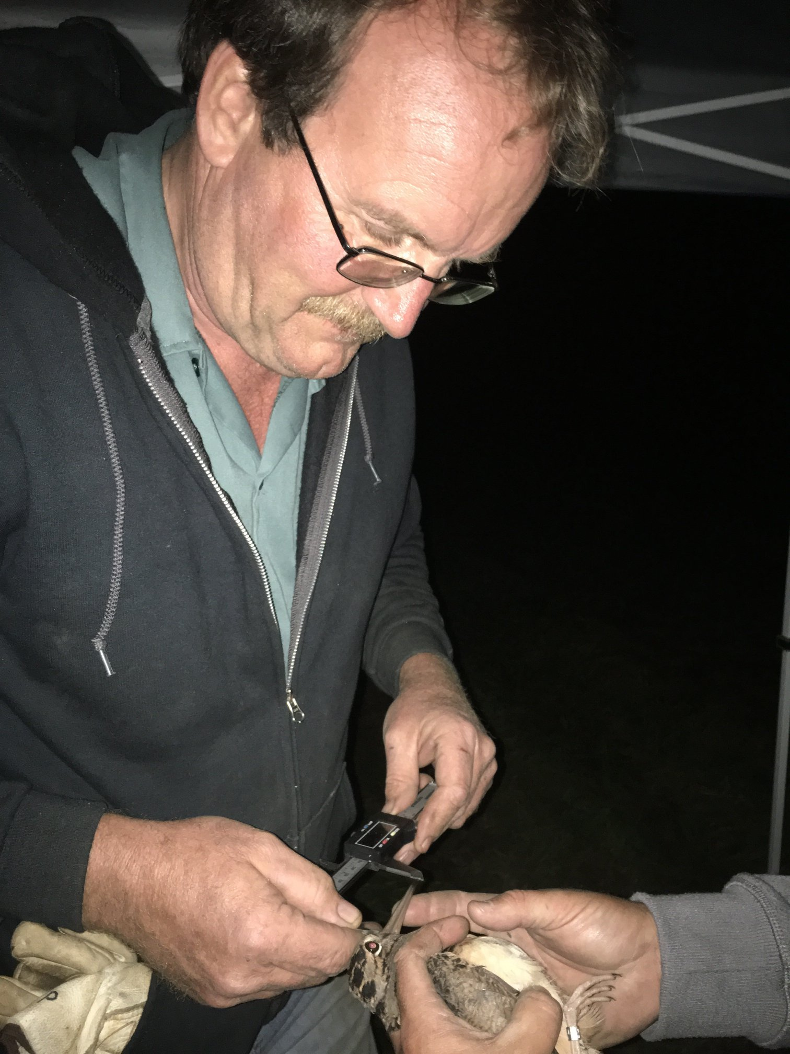
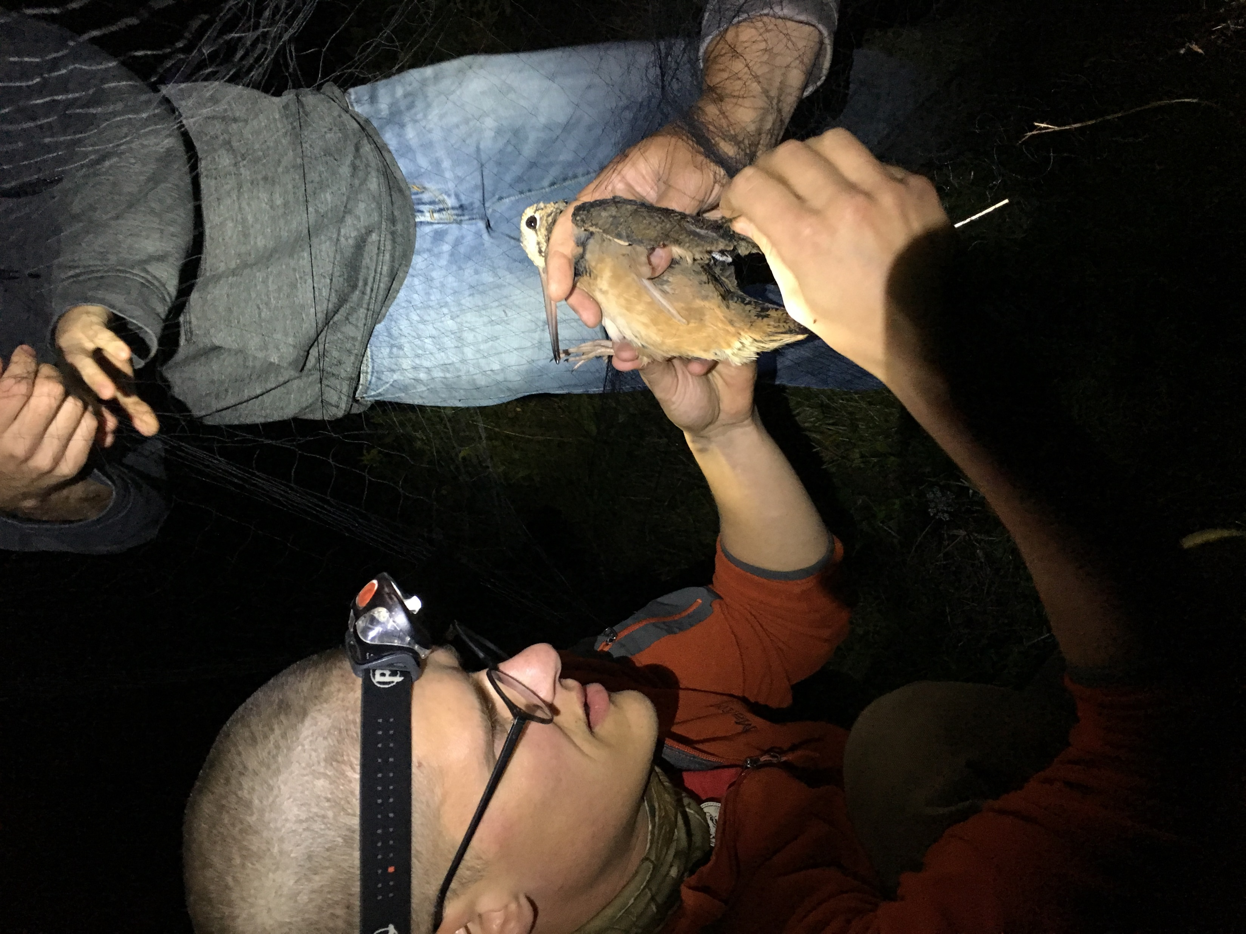
Eastern Woodcock Migratory Research Cooperative
49 birds tagged in Pennsylvania since 2018
Notes:
Outcome of PGC involvement in the Eastern Woodcock Migratory Research Cooperative
49 tags in Pennsylvania

Slide 4
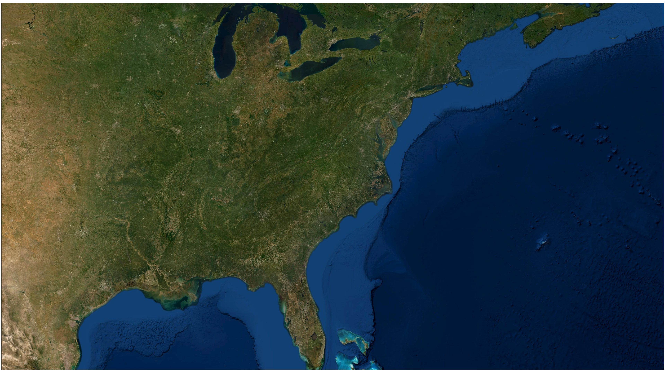
Notes:
Provides woodcock migratory data on an unprecedented scale
Possible to model woodcock migratory habitat just like we would model breeding habitat

Slide 5
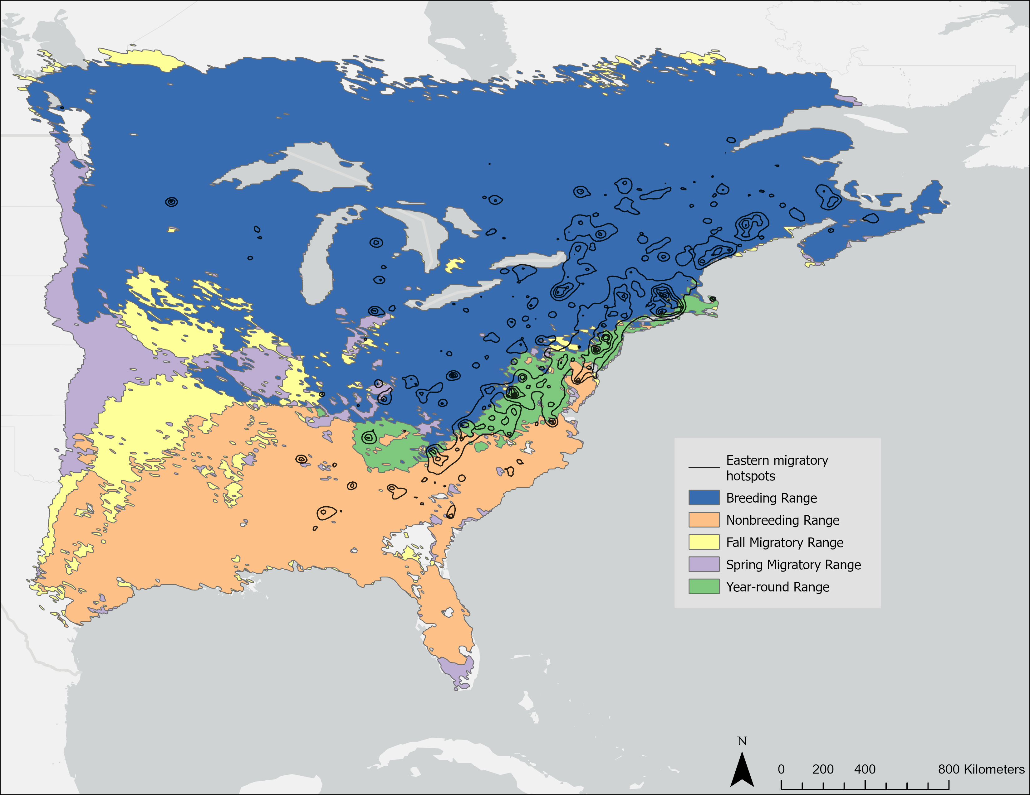
Motivation for W-PAST
Notes:
Pennsylvania provides both breeding and migratory habitat for woodcock in eastern North America
Prioritization of these habitat types will likely differ based on user preferences

Slide 6
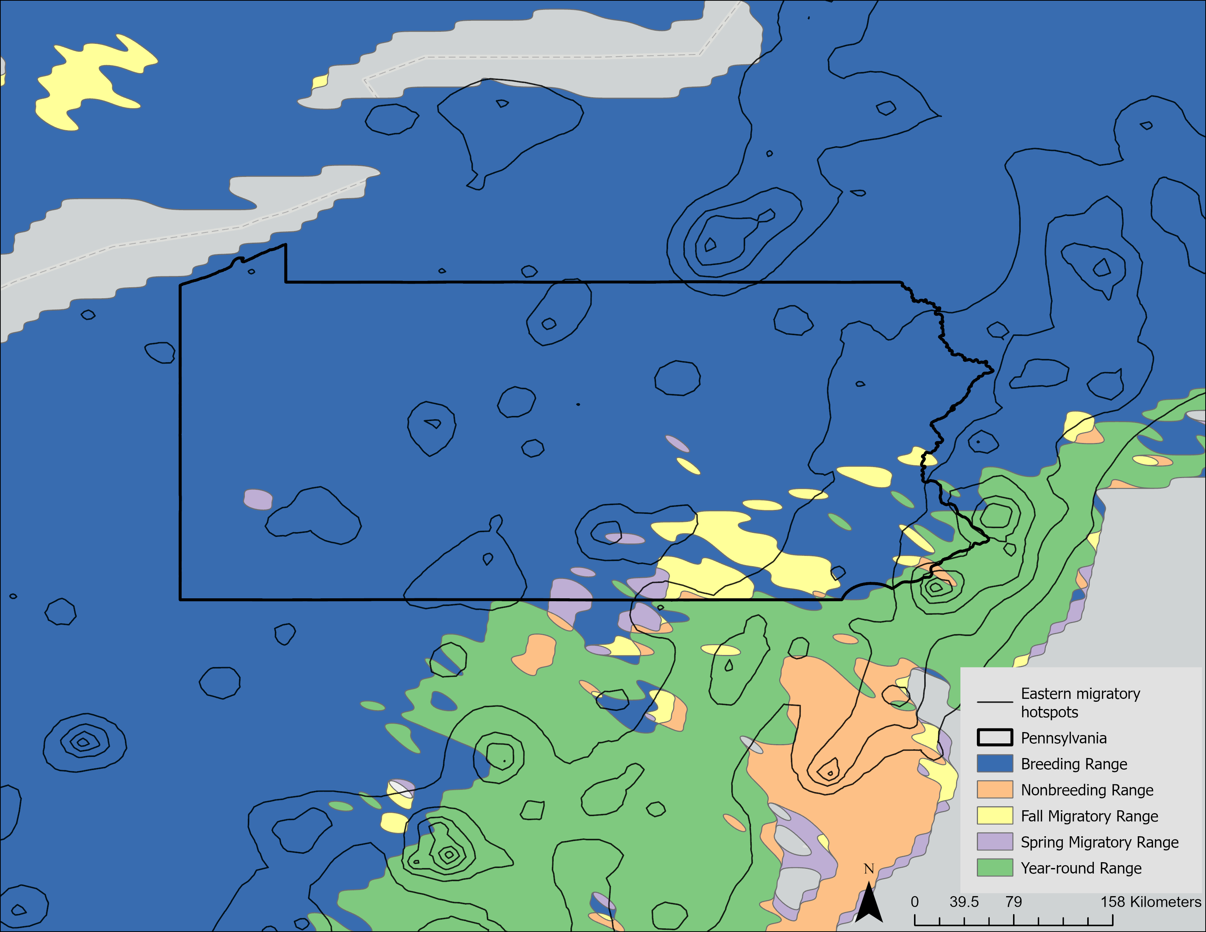
Motivation for W-PAST
Notes:
Pennsylvania provides both breeding and migratory habitat for woodcock in eastern North America
Prioritization of these habitat types will likely differ based on user preferences

Slide 7
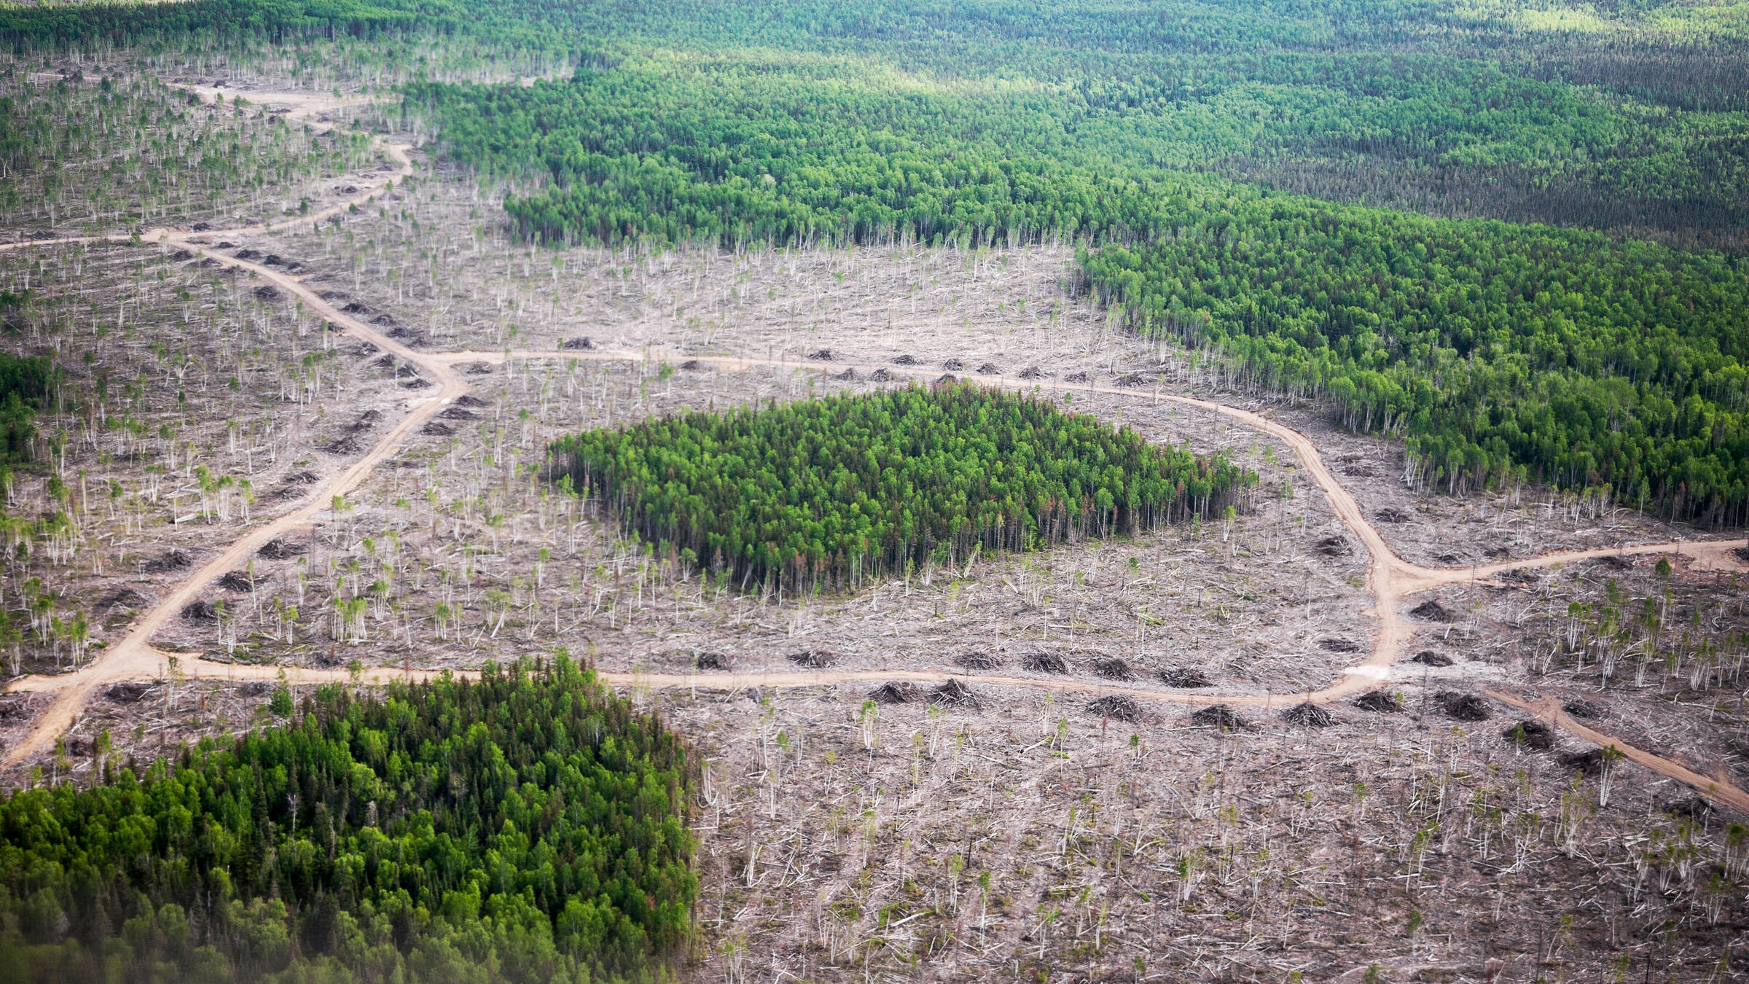
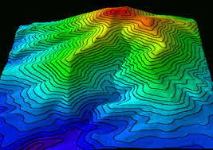
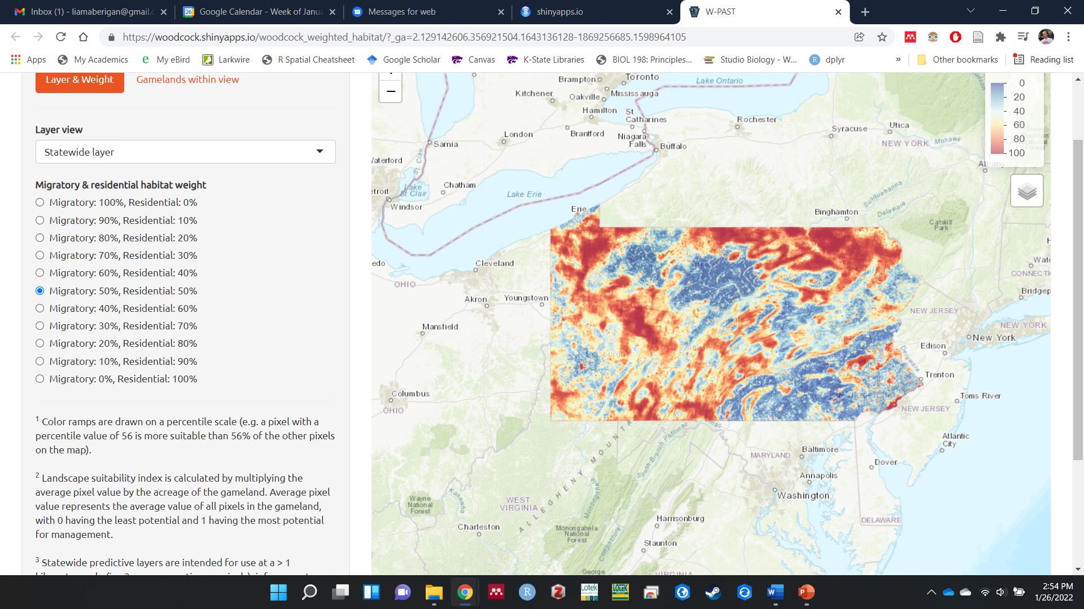
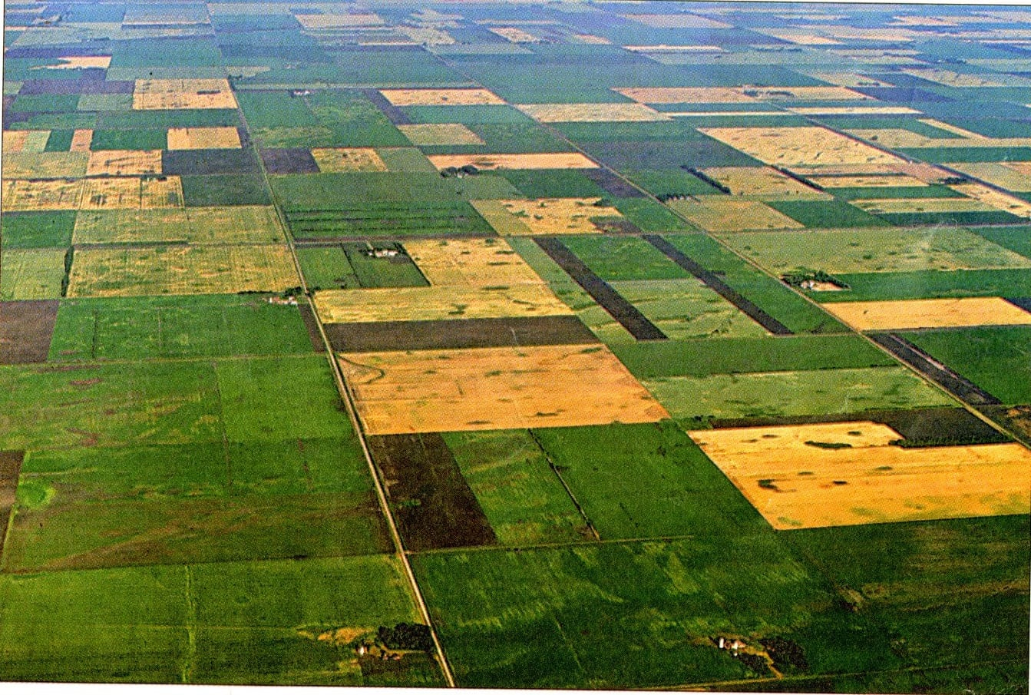

W-PAST uses landscape-scale variables to predict where woodcock habitat management is likely to be successful.
Notes:
(including landscape configuration, land use/land cover, topography, and soil moisture)

Slide 8
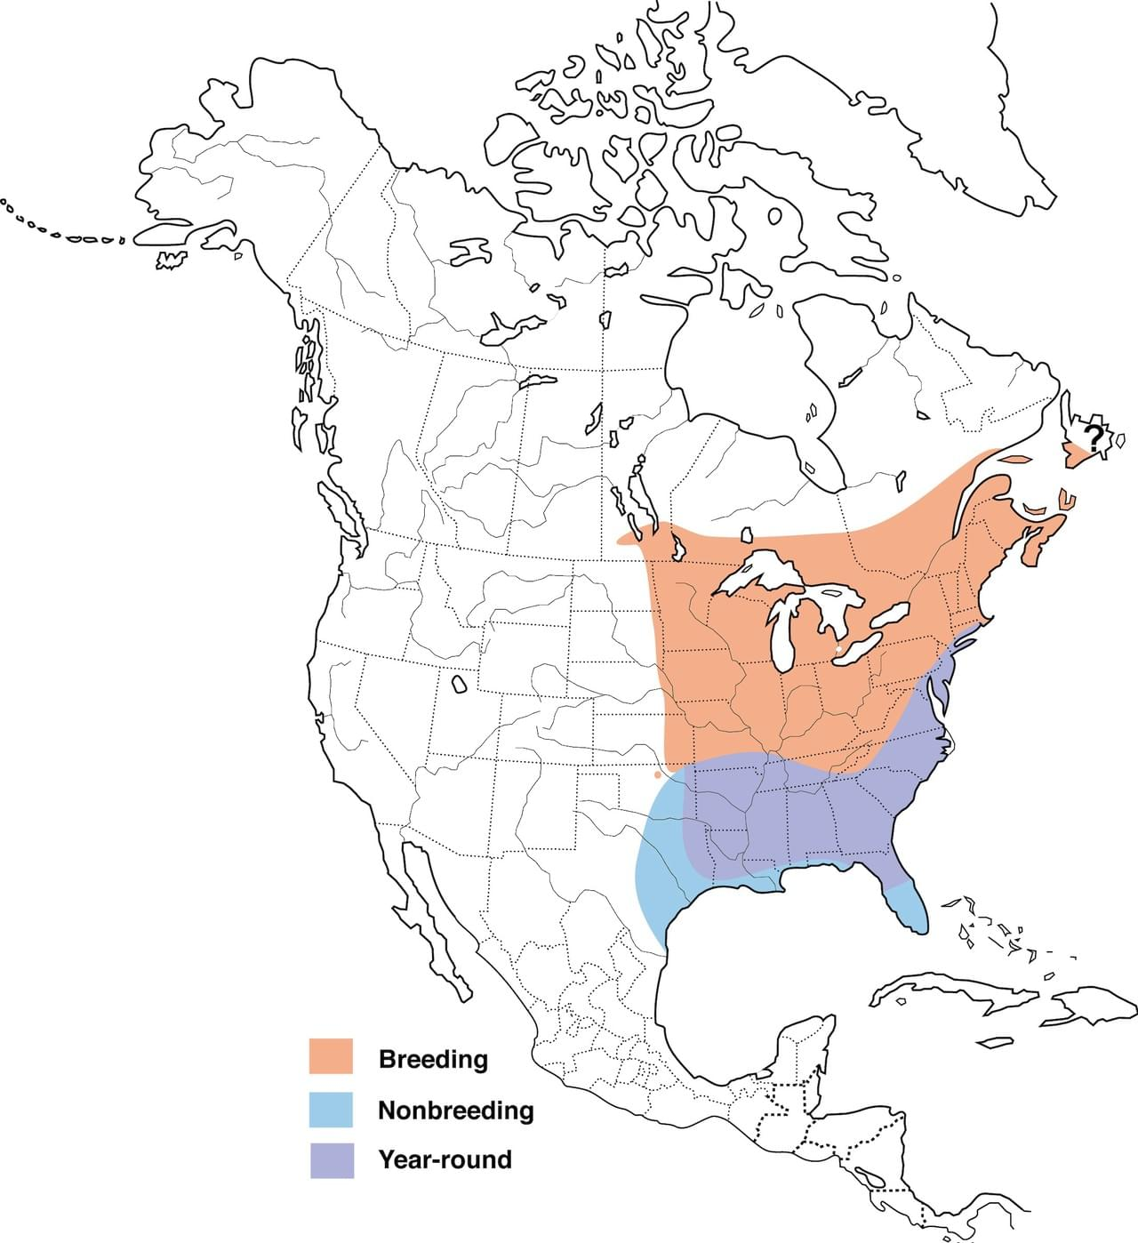
Season-specific predictions
Breeding
May - August
Spring Migration
Fall Migration
March - May
September - December
Nonbreeding
December - February
Notes:
W-PAST makes separate predictions for the breeding and migratory seasons

Slide 9
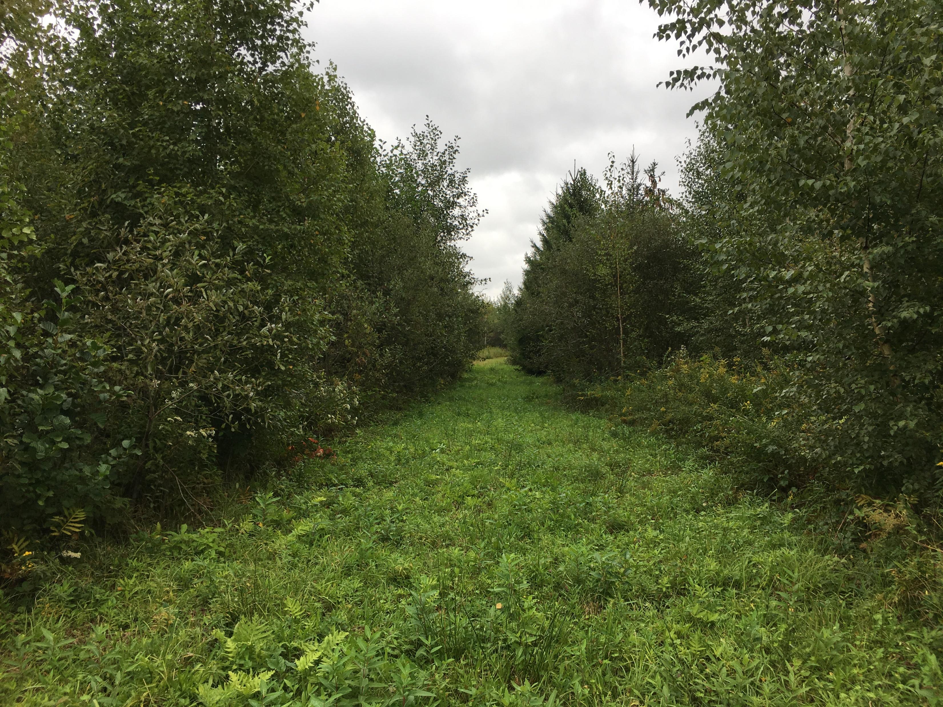
Season-specific predictions
Breeding season: habitat used between spring and fall migrations (May 15 – Sept. 15)
Measured using federal Singing Ground Surveys and PGC woodcock surveys
Pennsylvania, Alex Fish

Slide 10
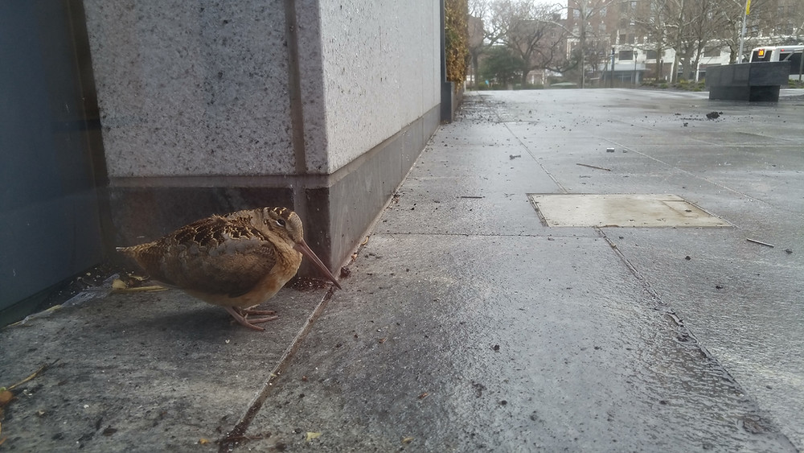
Season-specific predictions
Migratory seasons: areas used when resting between migratory flights
Measured using GPS locations from tagged woodcock

Slide 11
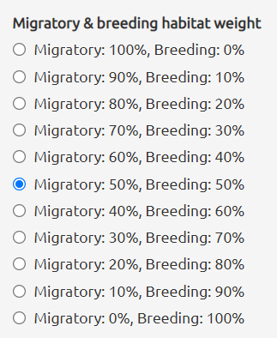
Weighting seasonal layers
The breeding and migratory layers can be weighted based on user preferences
Agency-specific priorities
Local/regional abundance of habitat
Migratory corridors
Notes:
Managing for islands of habitat

Slide 12
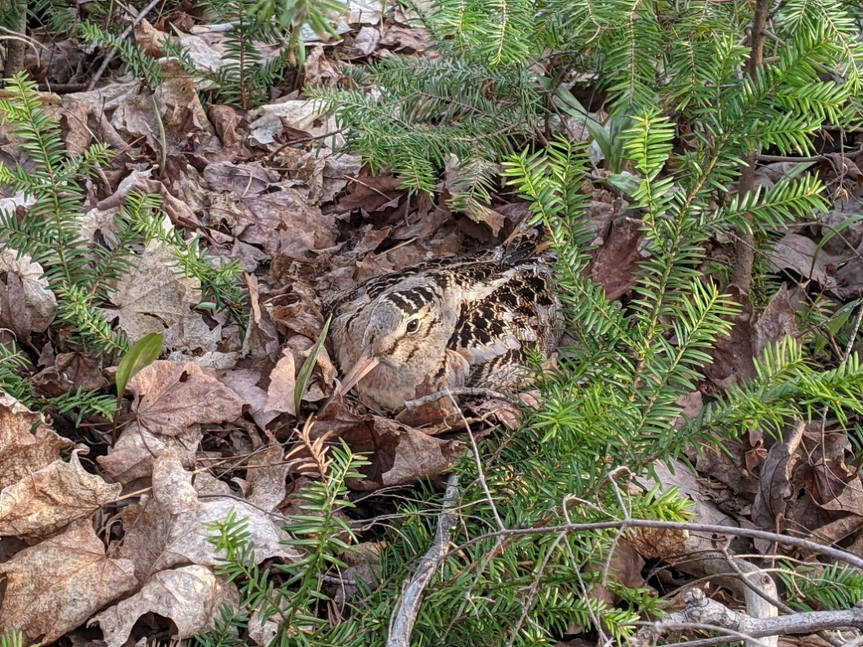
Photo credit: Mathieu Tetreault

